Slide 1

Equity Trading: AI Companies Recommendation

Slide 2

Executive Summary

Slide 3
Executive Summary
Our Customer is interested in investing in the AI Market and requested assistance on which stocks to invest in
In this project we have selected 19 AI Stocks and have leveraged Data Science to assess best AI Stocks to invest
We collected excellent quality stock data using Tradestation API’s, and performed clean-up and analysis using several techniques such as:
Price pattern,
Technical Indicators, and
Prediction Algo leveraging Prophet
Top 5 AI Stocks to invest are recommended and justification are provided in the Conclusion section of this presentation

Slide 4

Data Process
Data Collection, leveraging Tradestation WEB API’s
Cleanup, eliminating noise
Exploration & Insights, Technical Analysis with Prediction

Slide 5
Data Collection Process
Tradestation is one of the leading Trading Platform provider, enabling easy access to quality market data, while free of charge
The Process to collect the data:
Generated an Access Token, with the allowed Scope defined
Defined the base url
Defined the data length for historical purposes
Using list comprehension, we created a List composed of the json file for each AI Stock being evaluated
All collected data were stored locally, avoid having to call the API’s every time.

Slide 6
Data Cleanup Process
Created dictionary of Dataframe for each stock symbol
The Dataframe was filtered, resulting in Date, OHCLV bar information structure
Date was converted to Datetime and set as index and rest of the data was converted to float
Data is now ready for analysis

Slide 7
Exploration & Insights Process
Correlation Analysis
With Market Benchmarks (SPY and QQQ)
Between Stocks
52 weeks and 12 weeks Performance Analysis
Technical Analysis & Trend Analysis
Prediction Algo leveraging Prophet

Slide 8

Visuals

Slide 9
1. Market Correlation
 | Correlation with SPY | Correlation with QQQ
ACN | 0.79 | 0.65
ADBE | -0.01 | -0.05
AMD | -0.45 | -0.40
AMZN | 0.74 | 0.82
ANET | 0.94 | 0.94
ARM | 0.51 | 0.61
ASML | -0.69 | -0.53
AVGO | 0.79 | 0.86
GOOGL | 0.48 | 0.66
IBM | 0.85 | 0.73
INTC | -0.66 | -0.55
META | 0.89 | 0.85
MSFT | 0.35 | 0.53
NOW | 0.91 | 0.84
NVDA | 0.91 | 0.92
ORCL | 0.94 | 0.85
PLTR | 0.88 | 0.86
SAP | 0.93 | 0.87
TSM | 0.93 | 0.95

Slide 10
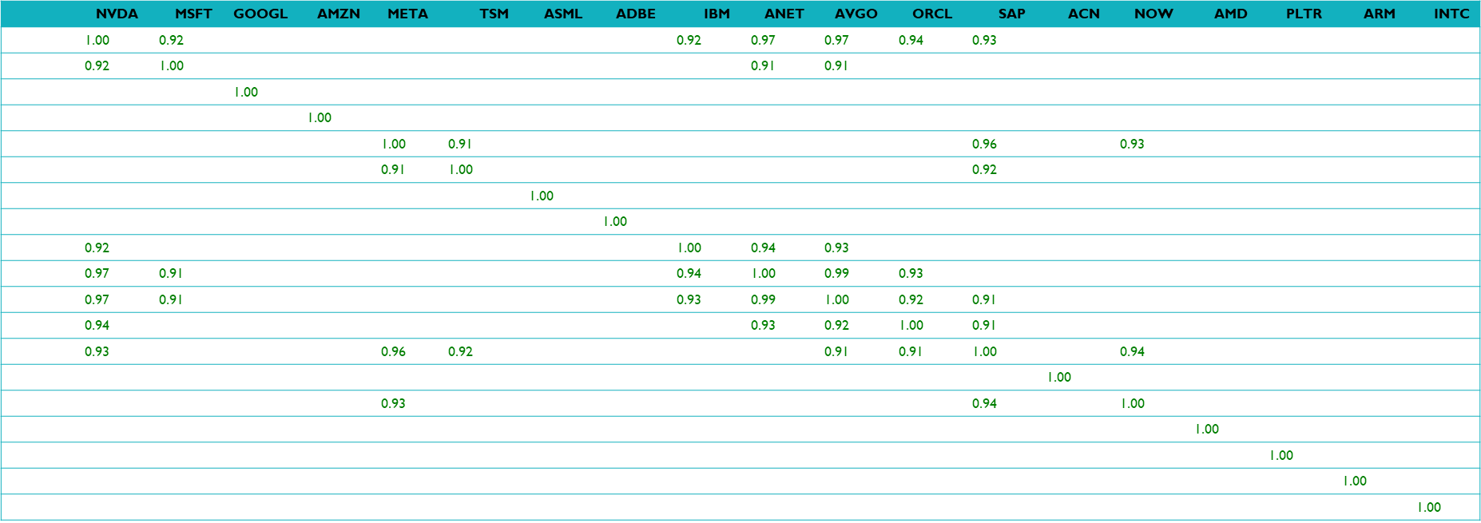
2. Stocks Correlation
Count of Corr. > 0.9
NVDA | 6
AVGO | 6
SAP | 6
ANET | 5
ORCL | 4
META | 3
IBM | 3
MSFT | 3
TSM | 2
NOW | 2
ASML | 0
ADBE | 0
AMZN | 0
GOOGL | 0
ACN | 0
AMD | 0
PLTR | 0
ARM | 0
INTC | 0

Slide 11
3. 52 Weeks and 12 Weeks Performance
 | 52 Weeks Performance | 12 Weeks Performance
PLTR | 335.46 | 62.88
NVDA | 136.73 | -0.50
AVGO | 98.41 | 38.91
ARM | 97.51 | 7.97
TSM | 91.51 | 7.50
ANET | 84.43 | 23.33
SAP | 64.75 | 13.29
META | 60.77 | 7.54
ORCL | 57.35 | -0.55
AMZN | 48.52 | 22.83
NOW | 46.42 | 15.35
GOOGL | 35.30 | 19.83
IBM | 30.78 | 4.47
MSFT | 7.48 | 0.08
ASML | 0.68 | 7.21
ACN | -2.06 | -1.21
ADBE | -28.65 | -9.79
AMD | -29.82 | -21.73
INTC | -54.79 | -4.01

Slide 12
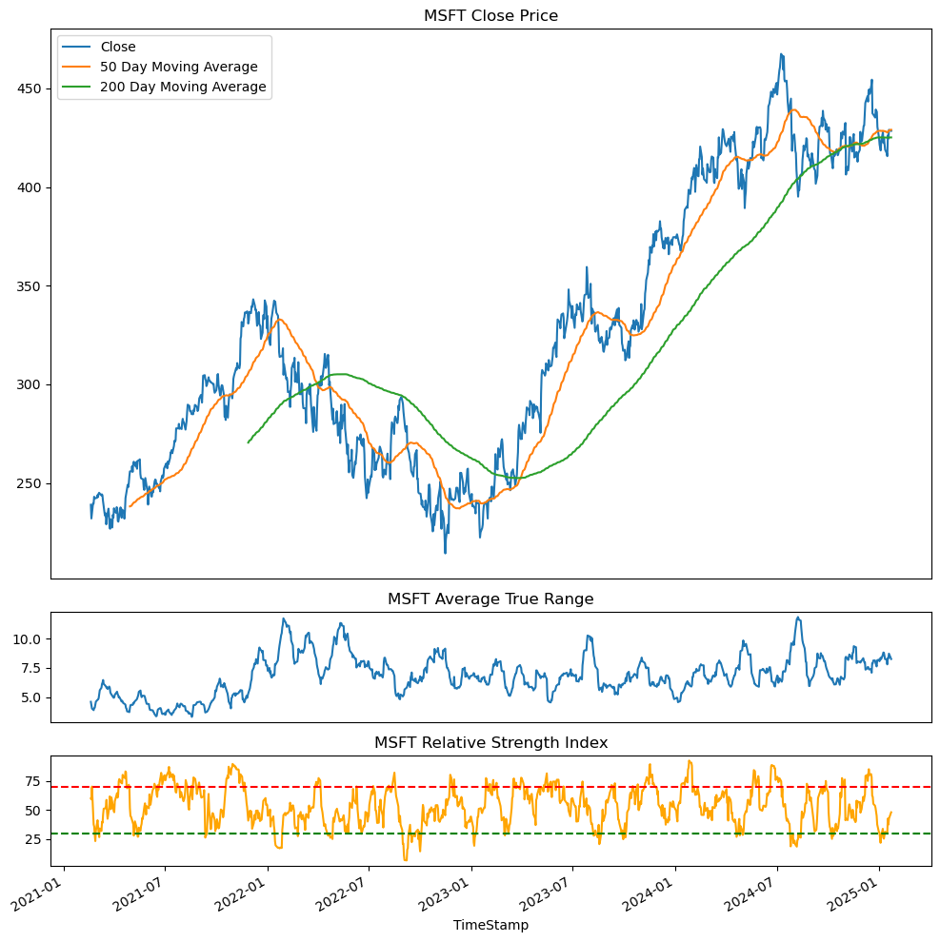
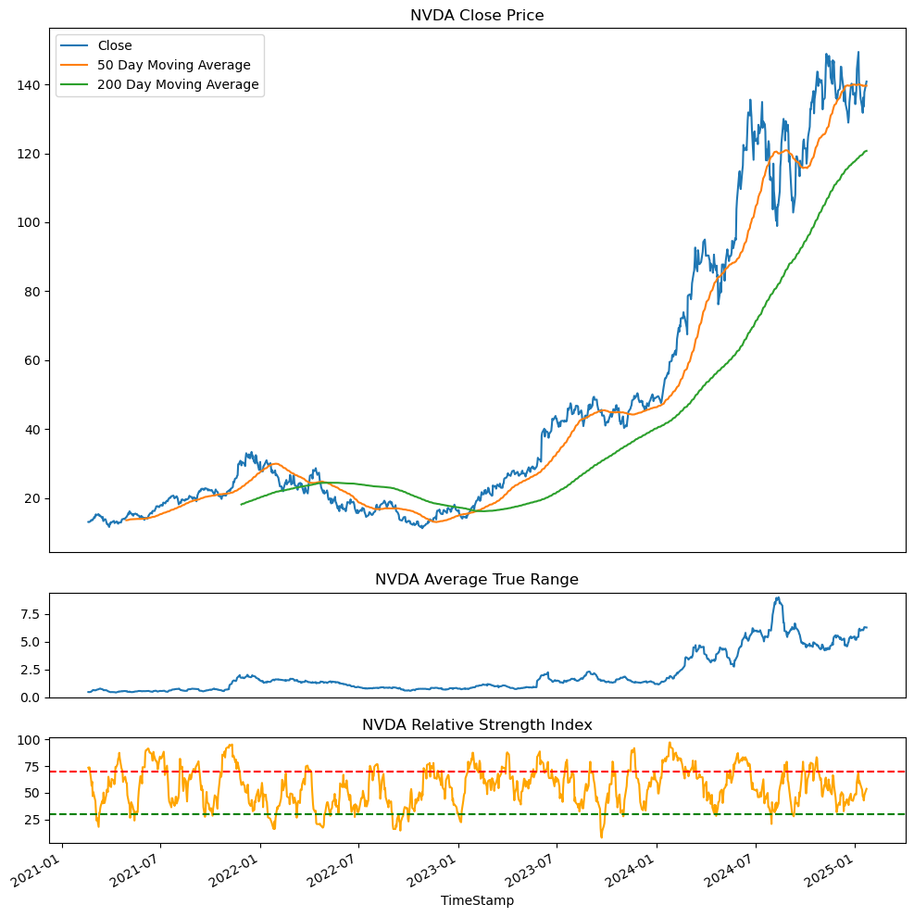
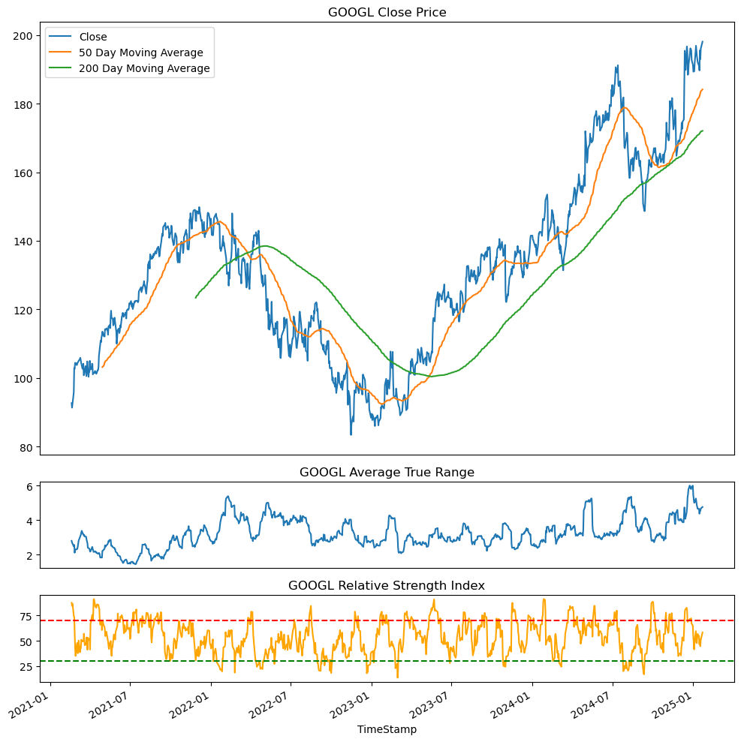
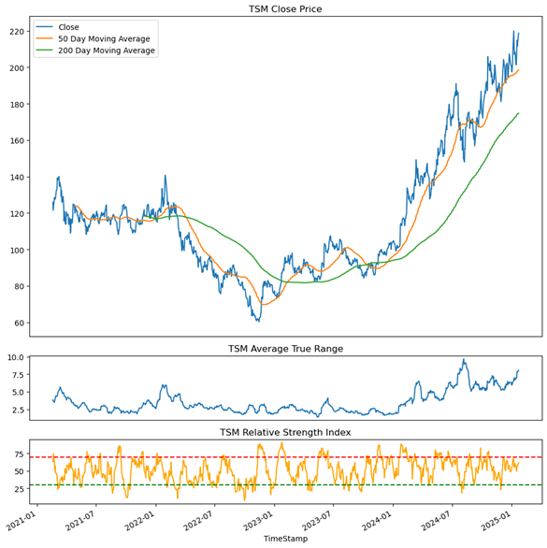
4. Technical Analysis (1/5)
MICROSOFT
NVIDIA
ALPHABET
TSM

Slide 13
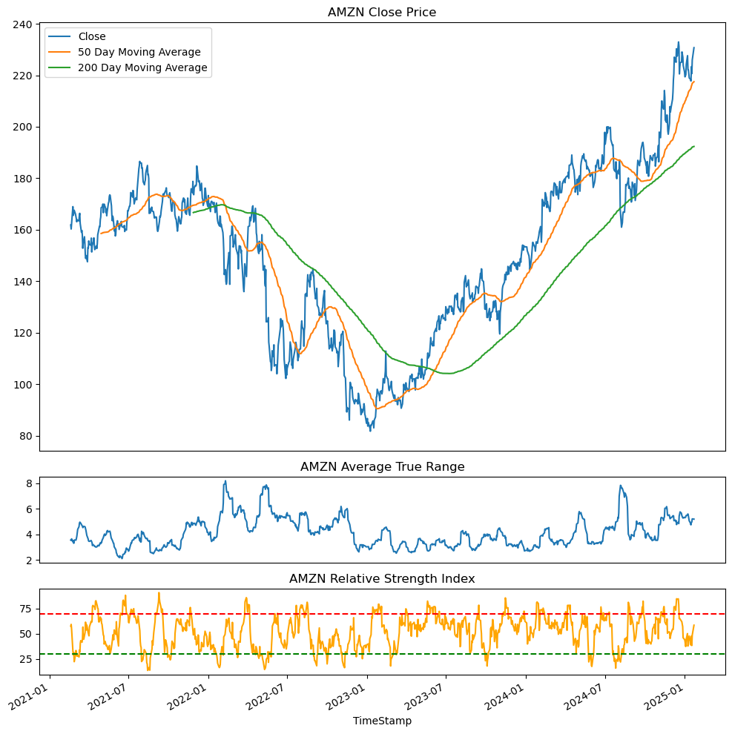
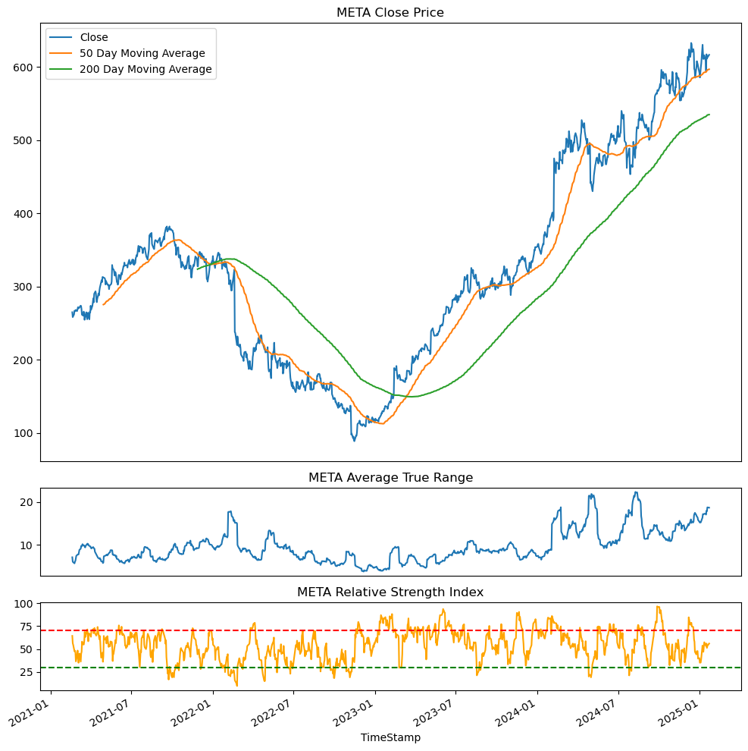
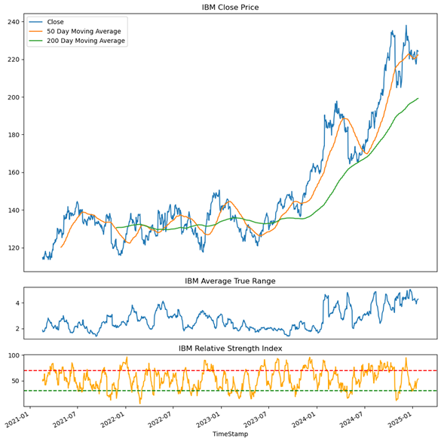
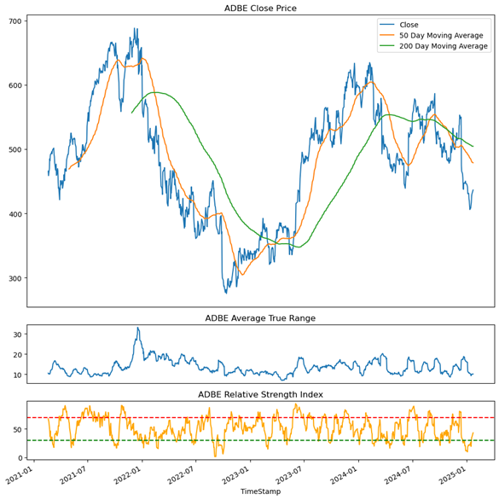
4. Technical Analysis (2/5)
AMAZON
META
IBM
ADOBE

Slide 14
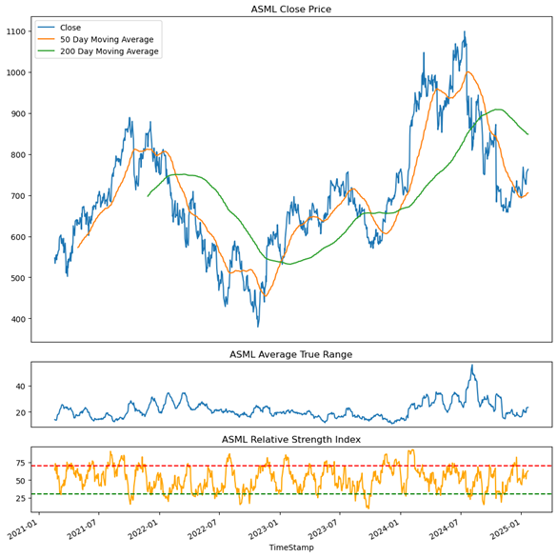
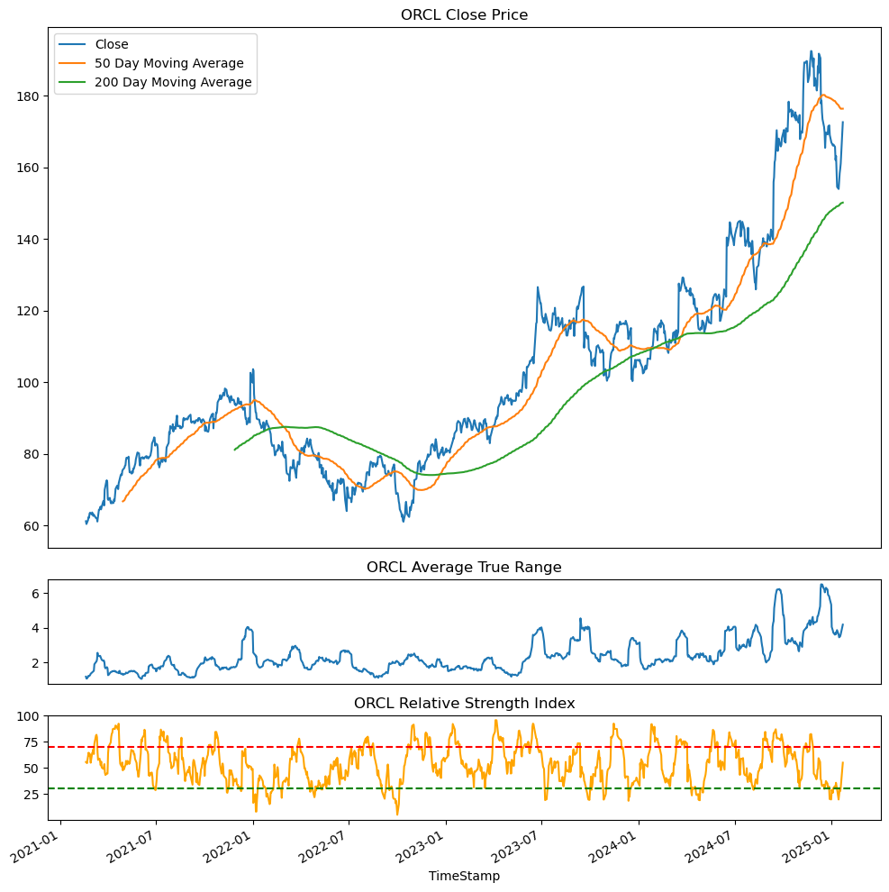
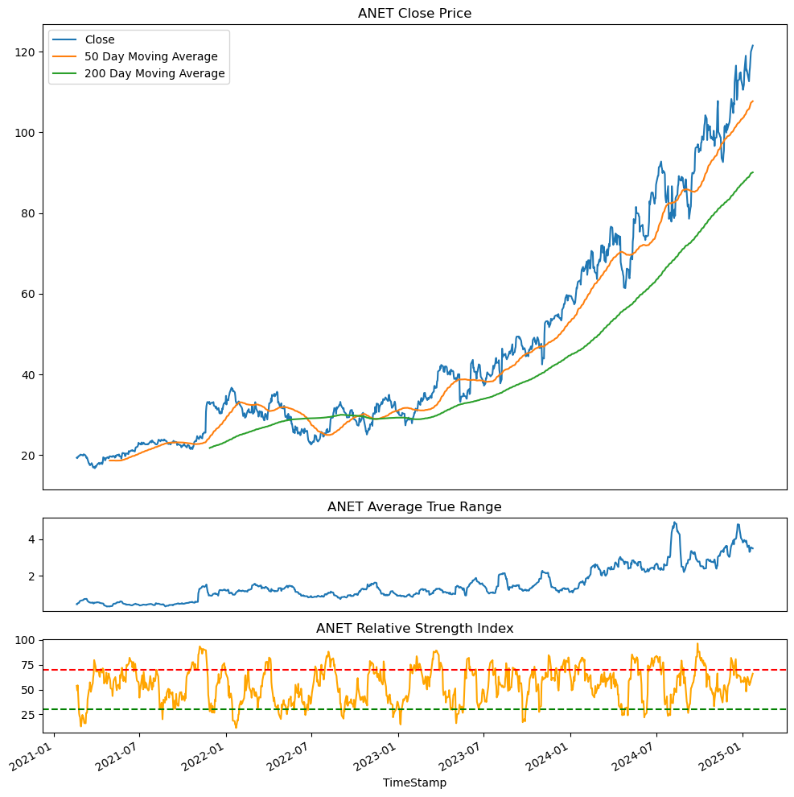
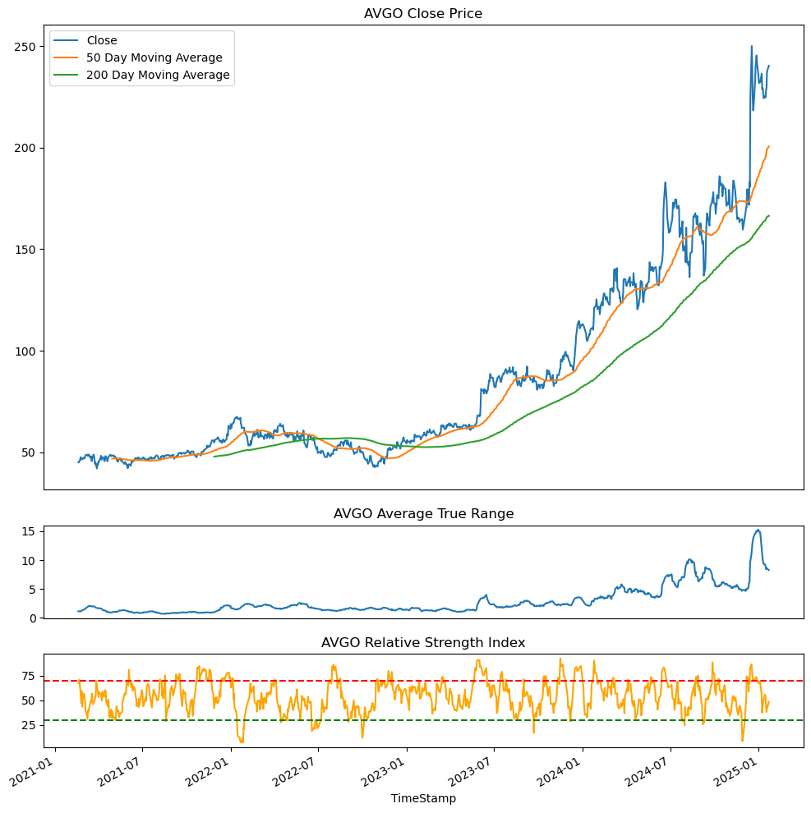
4. Technical Analysis (3/5)
ASML
ORCL
ANET
AVGO

Slide 15
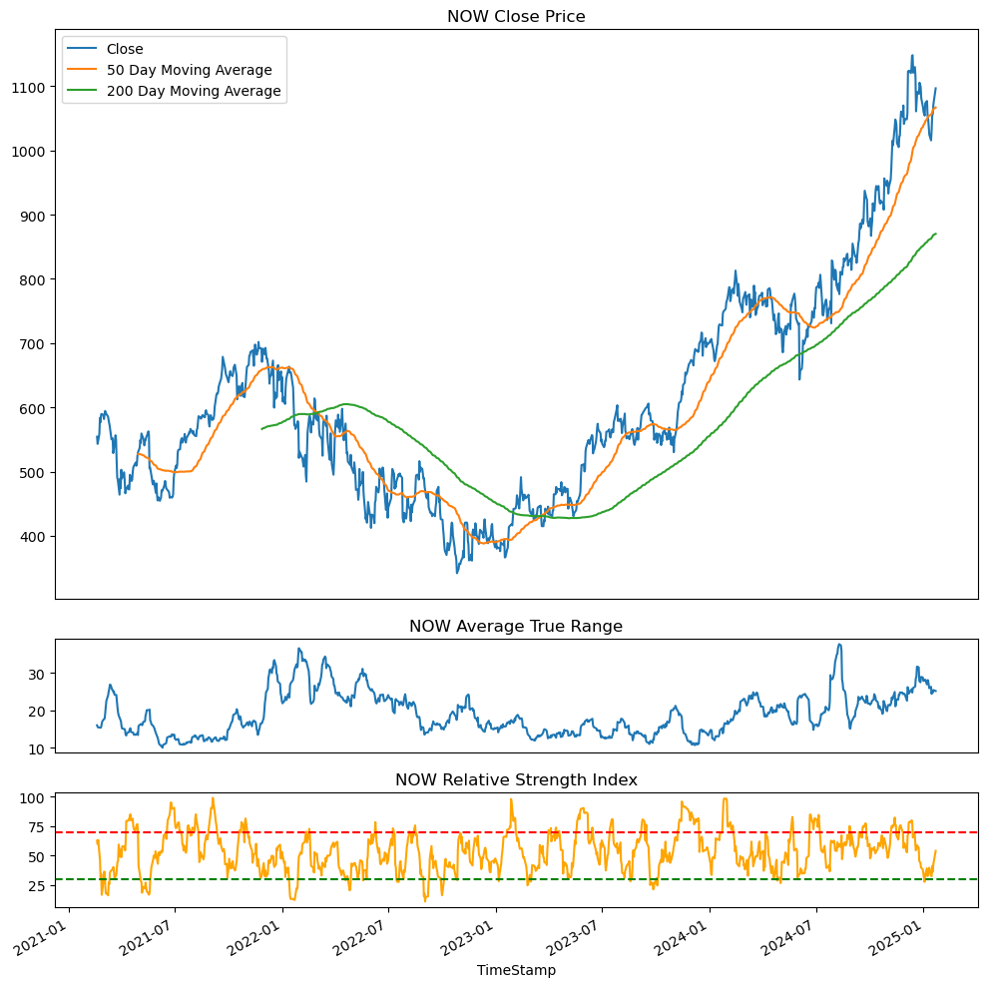
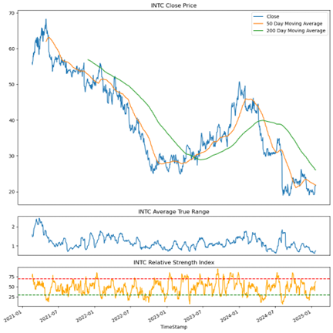
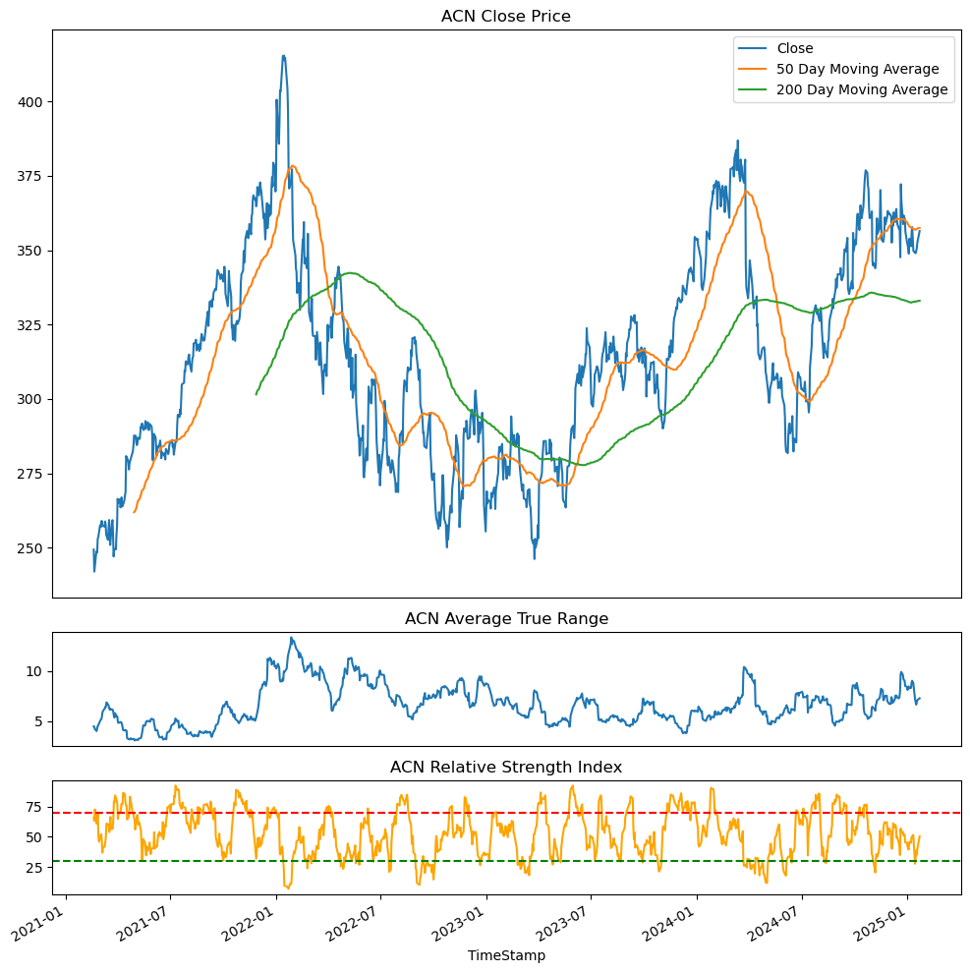
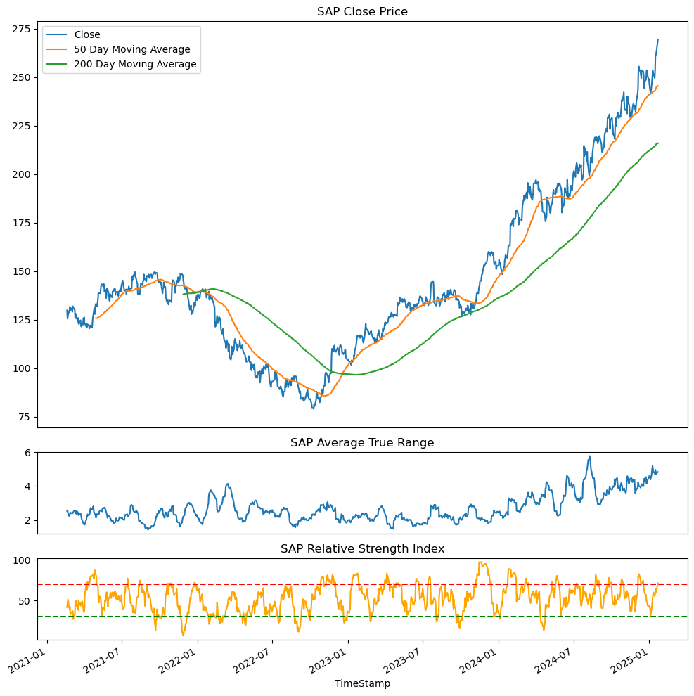
4. Technical Analysis (4/5)
NOW
INTEL
ACN
SAP

Slide 16
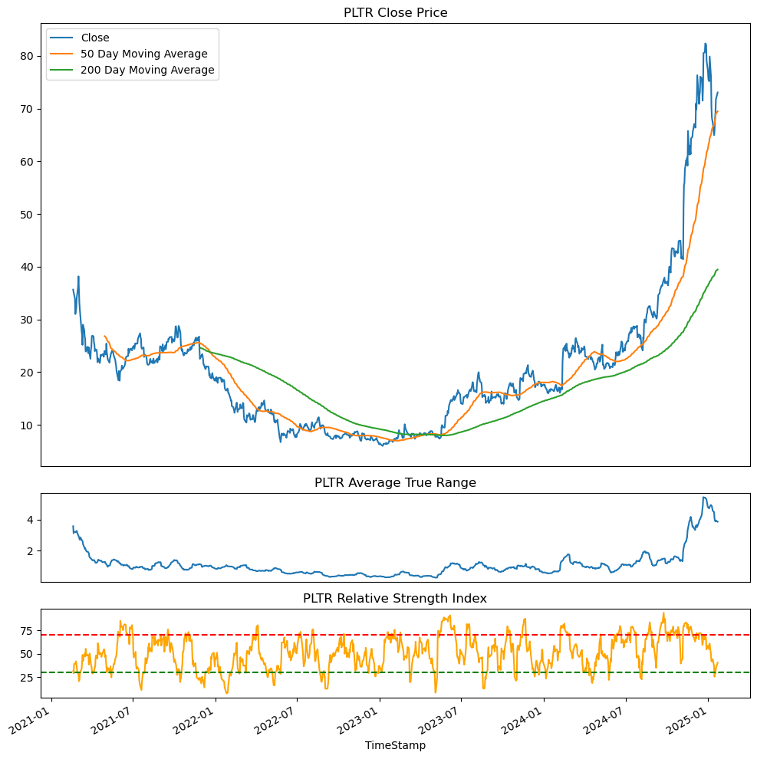
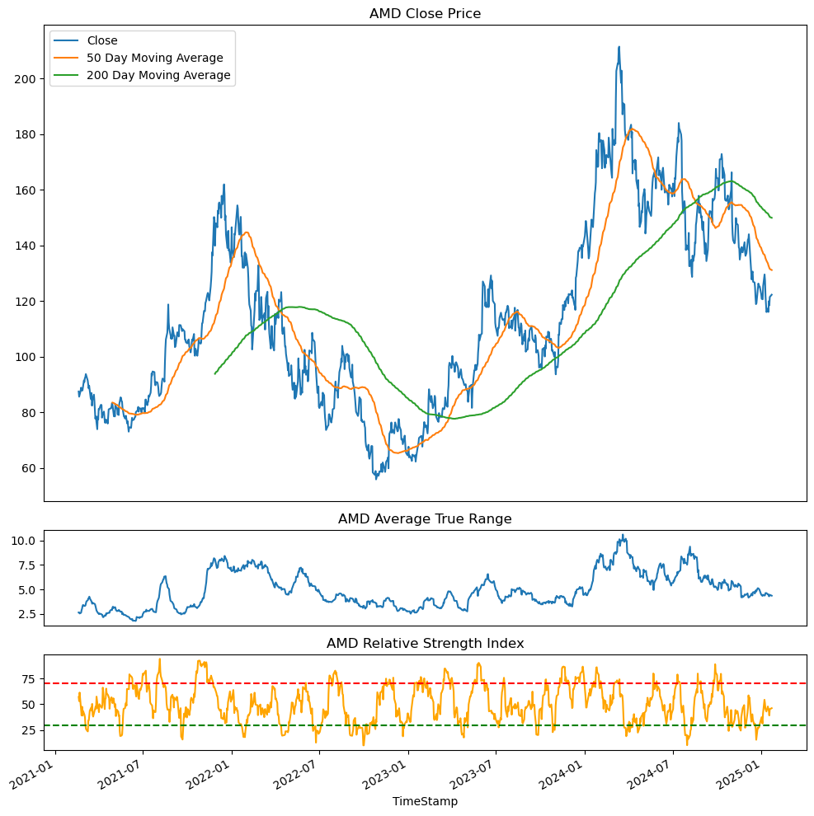
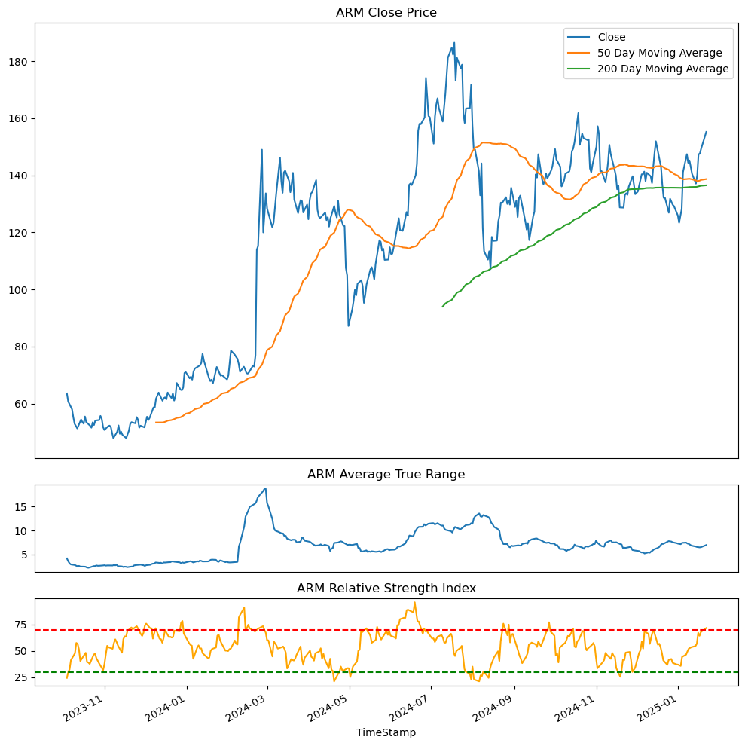
4. Technical Analysis (5/5)
PLTR
AMD
ARM

Slide 17
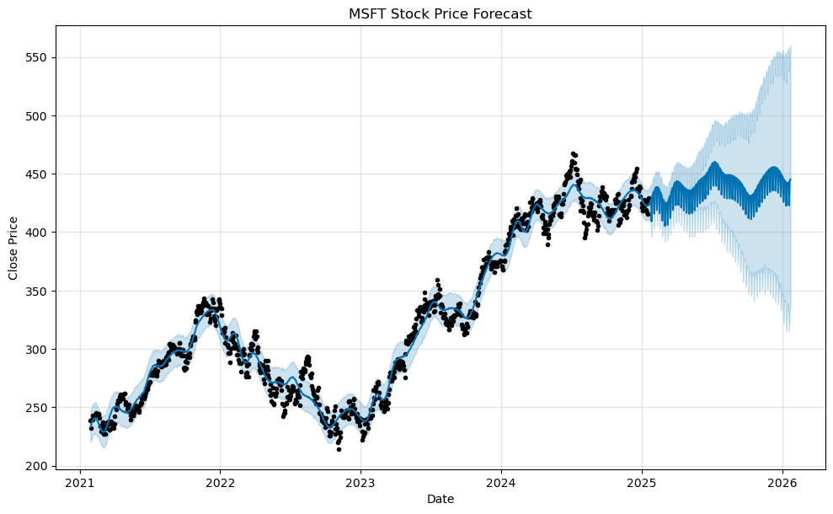
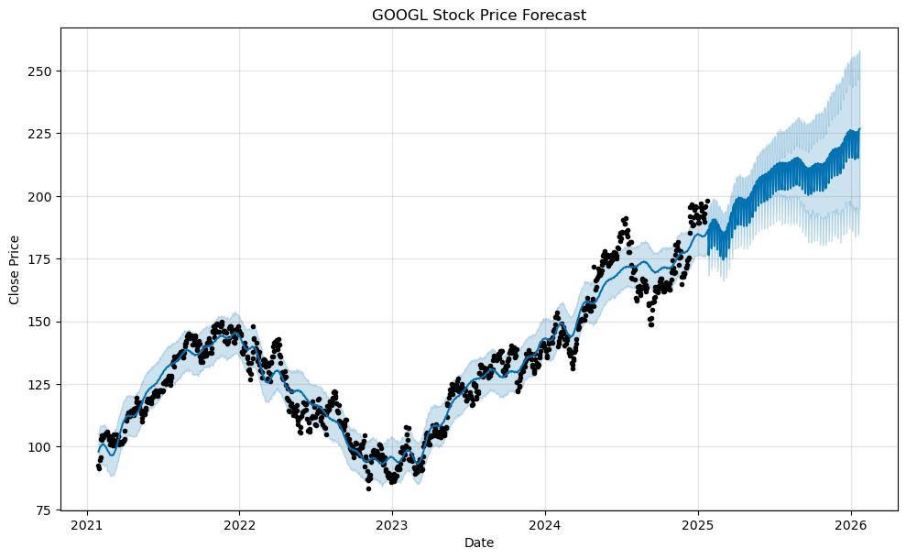
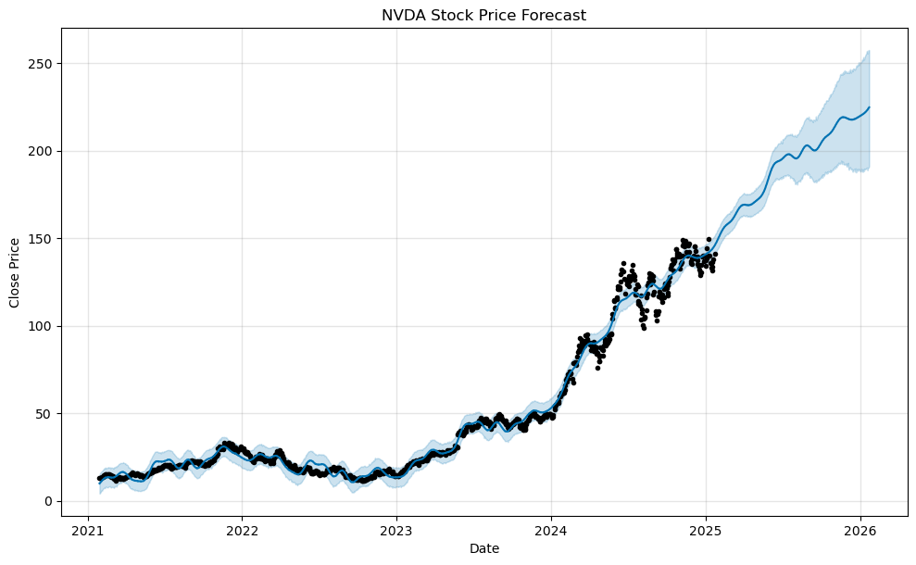
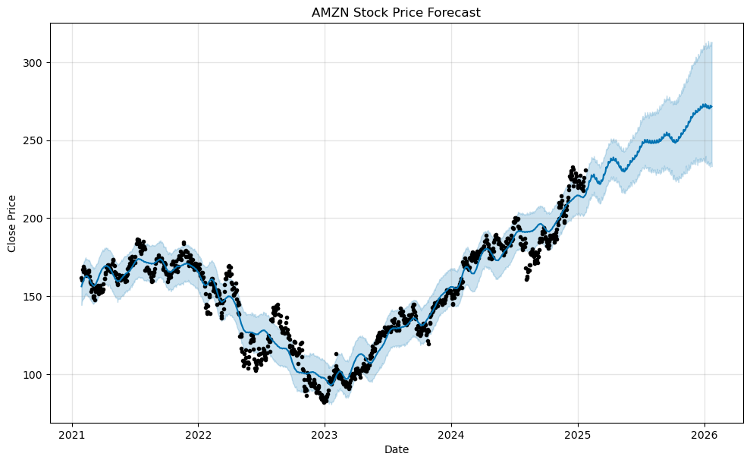
5. Prediction Analysis (1/5)
MICROSOFT
ALPHABET
NVIDIA
AMZN

Slide 18
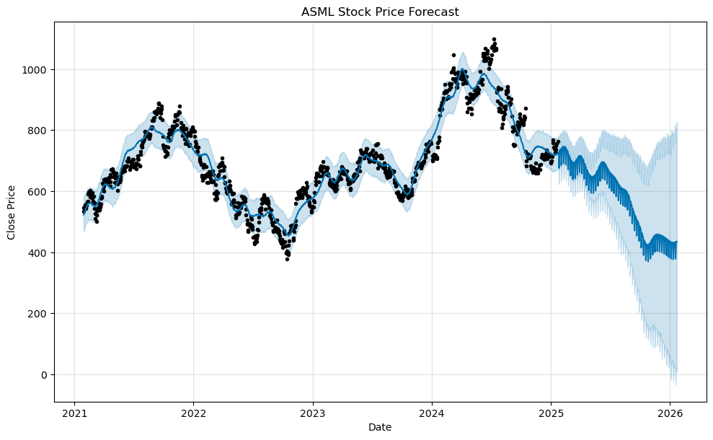
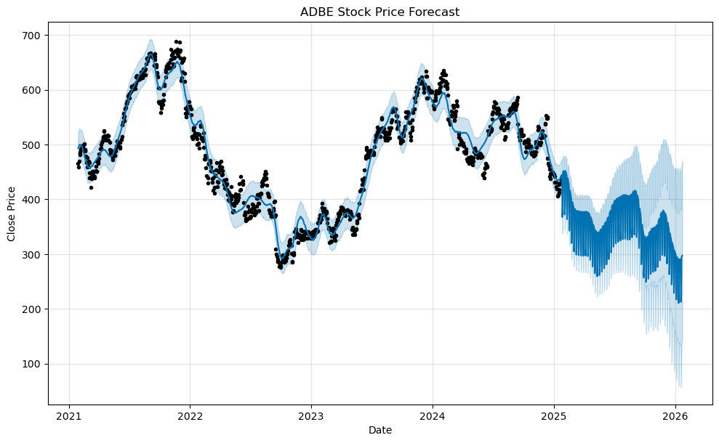
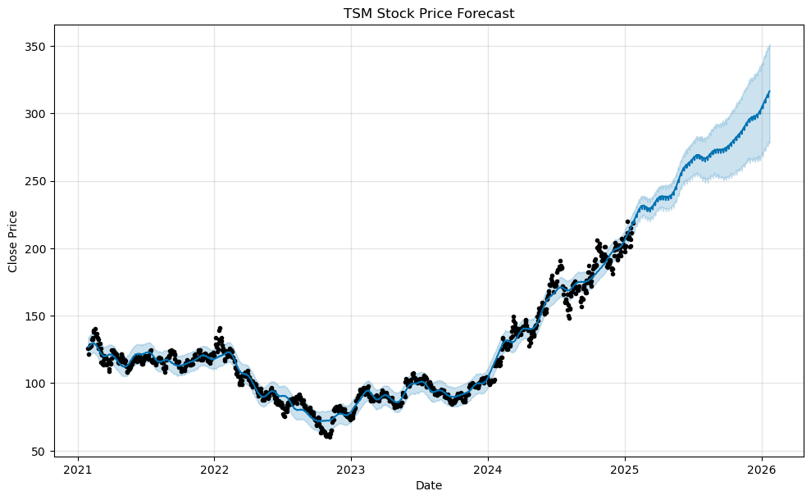
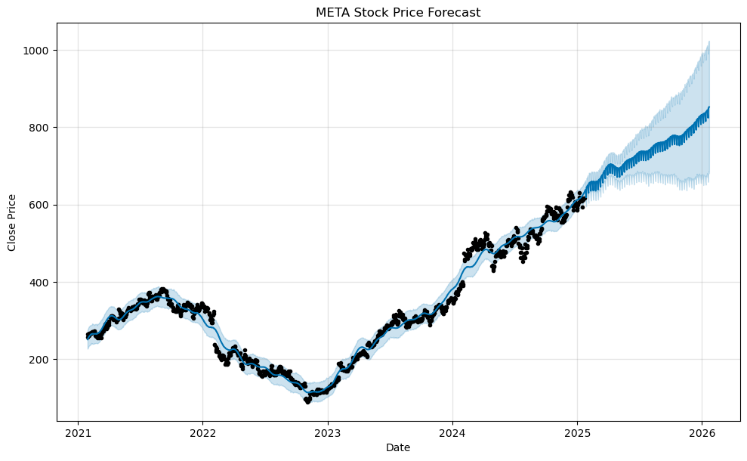
5. Prediction Analysis (2/5)
ASML
ADBE
TSM
META

Slide 19
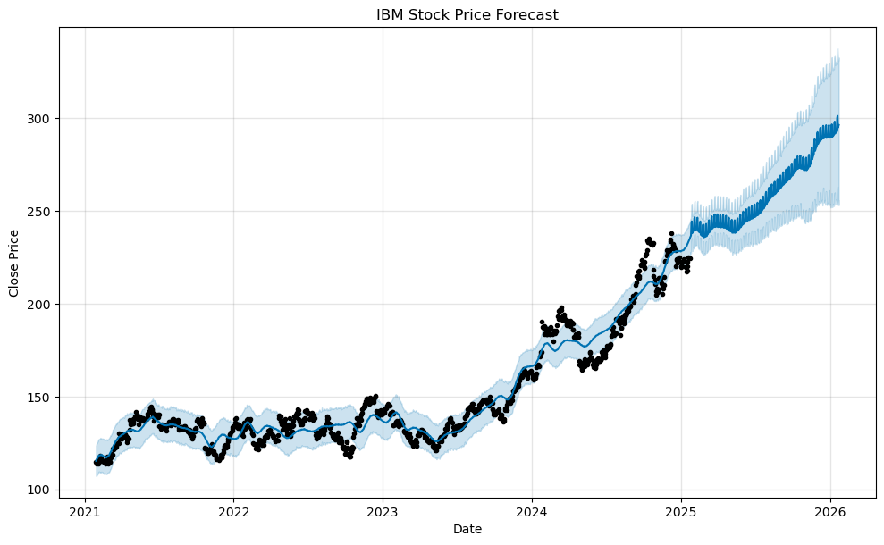
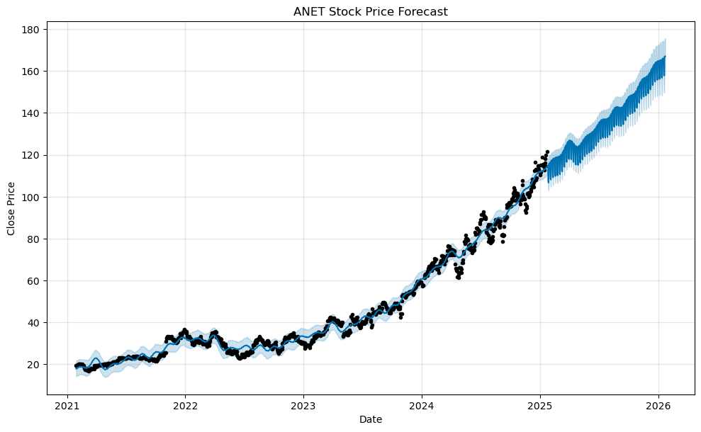
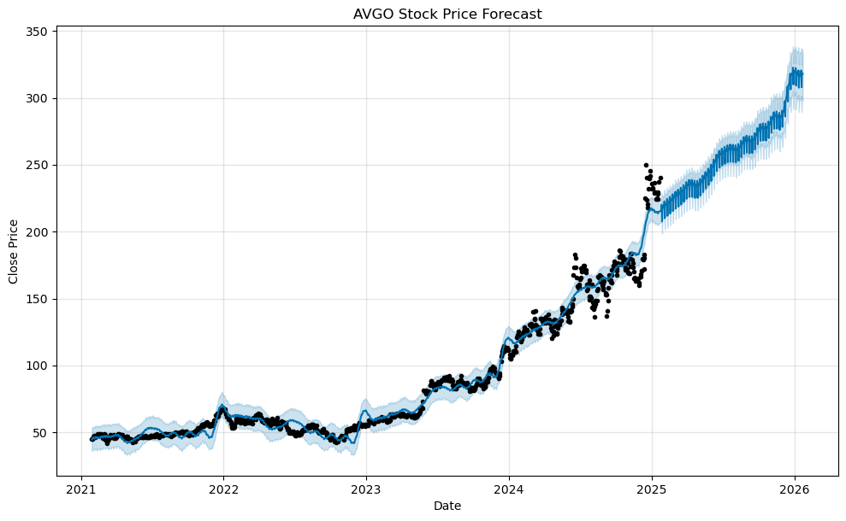
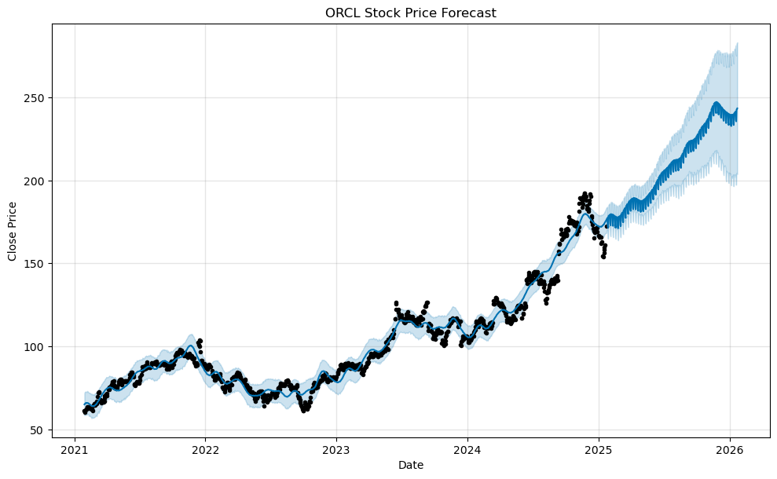
5. Prediction Analysis (3/5)
IBM
ANET
AVGO
ORCL

Slide 20
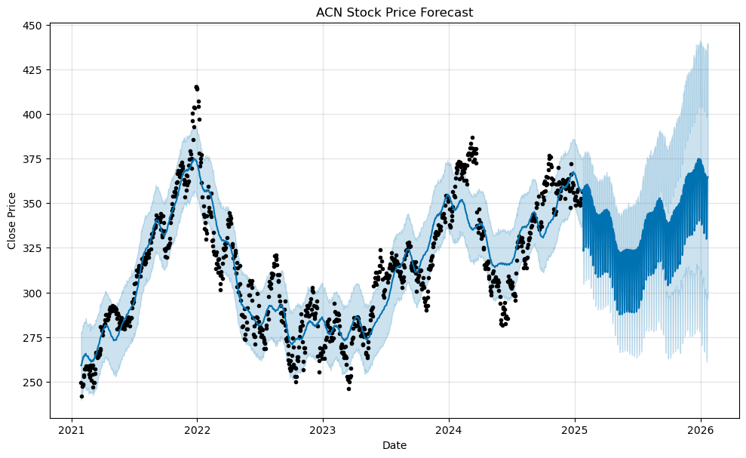
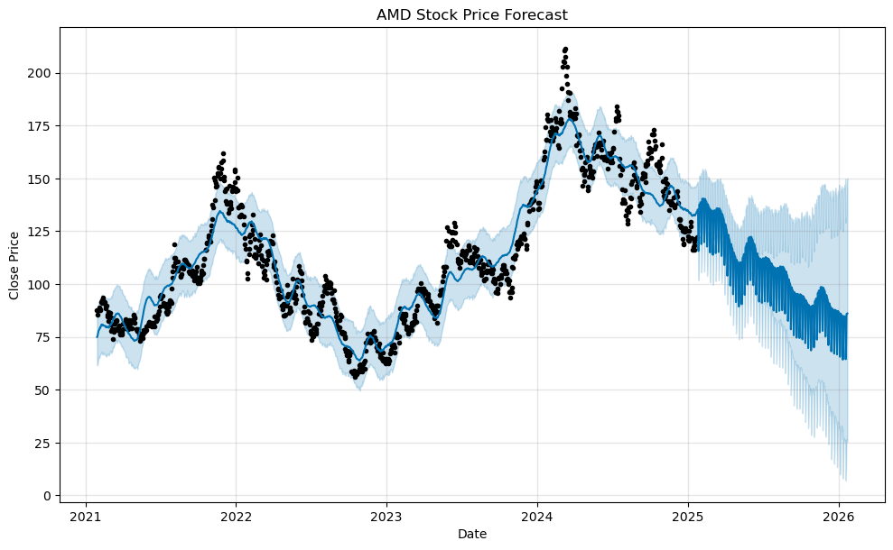
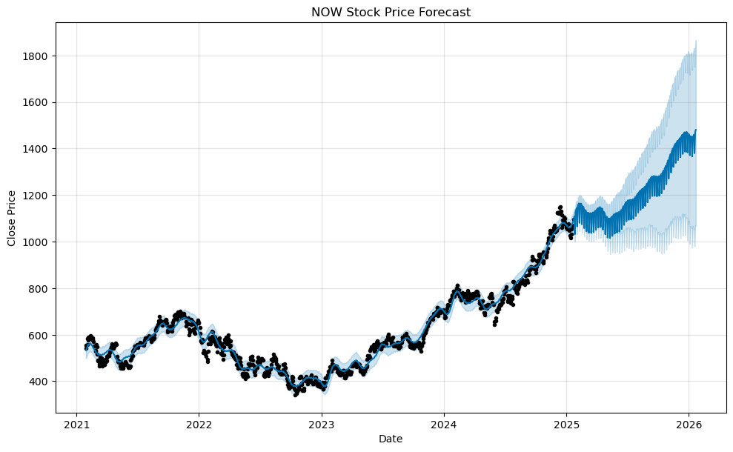
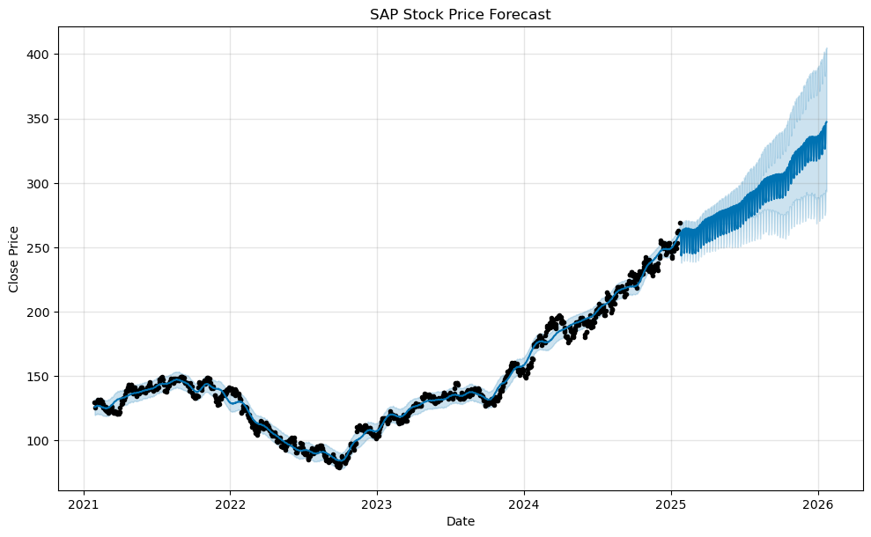
5. Prediction Analysis (4/5)
ACN
AMD
NOW
SAP

Slide 21
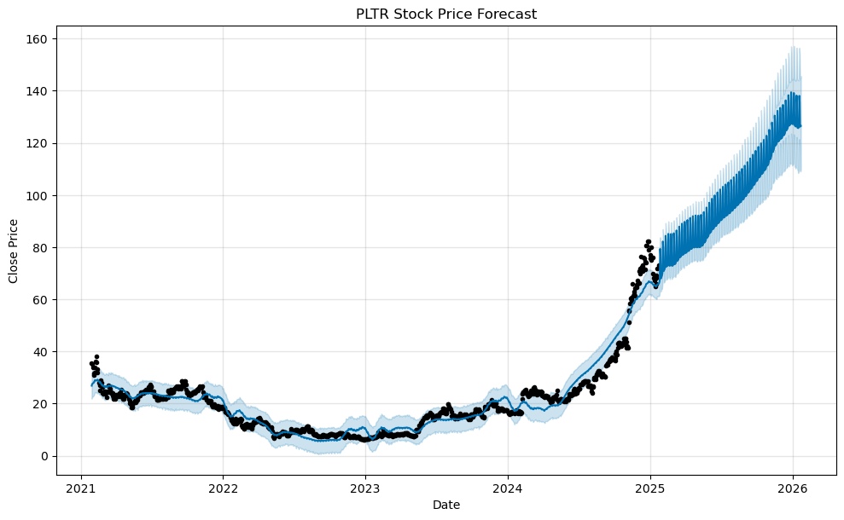
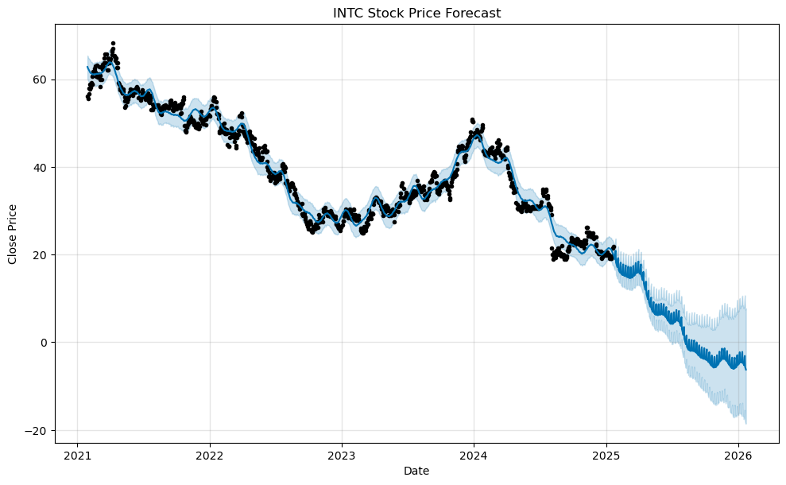
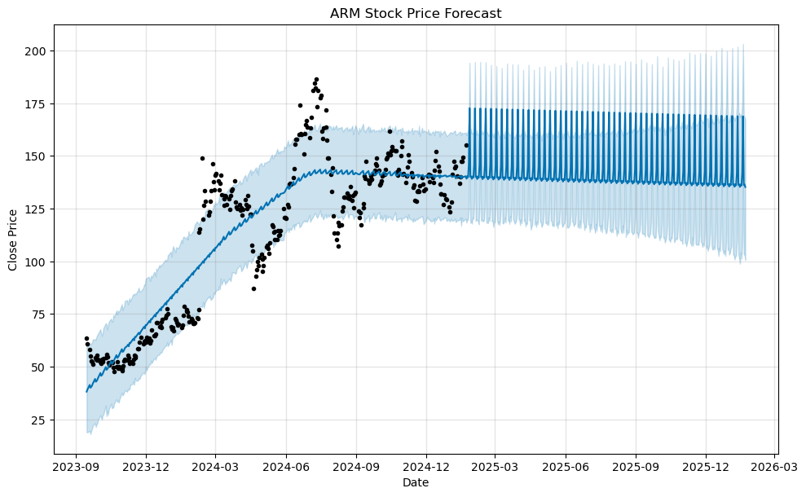
5. Prediction Analysis (5/5)
PLTR
INTEL
ARM

Slide 22

Recommendations
Timeframe, Diversification and Risk Assessment

Slide 23
Screening based on Several Criteria's
Round 1:
Technical Analysis
MSFT
AMZN
NVDA
META
GOOGL
IBM
TSM
ORCL
ANET
AVGO
NOW
SAP
PLTR
ARM
Round 2:
Prediction Algo
MSFT
AMZN
NVDA
META
GOOGL
IBM
TSM
ORCL
ANET
AVGO
NOW
SAP
PLTR
ARM
Round 3:
52w performance
MSFT
AMZN
NVDA
META
GOOGL
IBM
TSM
ORCL
ANET
AVGO
NOW
SAP
PLTR
ARM
Round 4:
Count Correlation > 0.9
MSFT
AMZN
NVDA
META
GOOGL
IBM
TSM
ORCL
ANET
AVGO
NOW
SAP
PLTR
ARM
Looking at Trend, ATR, RSI
Looking at one-year prediction
Ranking by 52W Performance
Ranking Corr. Count

Slide 24
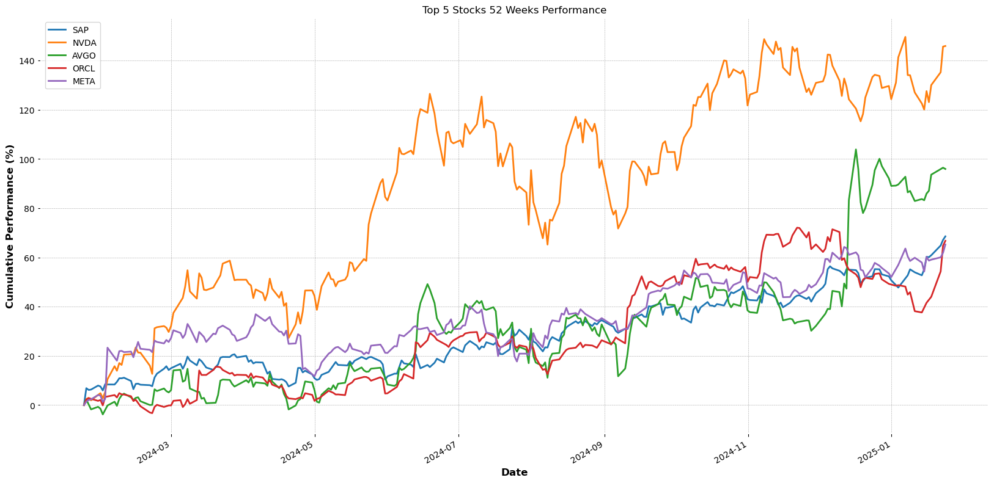
52 Weeks Performance

Slide 25
Recommendations
Short-Term vs. Long-Term:
Short-term investment recommendations based on current trends.
Long-term investment recommendations considering outlook.
Diversification:
Suggested mix of Nvidia, Oracle, Arista Networks, Broadcom, and SAP stocks to spread risk.
Risk Assessment:
Evaluation of stability and potential returns for each stock.
Recommendation is also distributed across sectors:
Nvidia and Broadcom – Semiconductor
Oracle – Software Infrastructure (Cloud Provider)
Arista Networks – Hardware Infrastructure (Networking)
SAP – Supply Chain (ERP Software)

Slide 26

Thank you
Austin McCormick
Devin Carter
Mehdi Afiatpour

